Slide 1

PROJECT BY
PRANAV
(102317278)
RAJESH GOUD
(102317197)

Slide 2
SCOPE OF THE PROJECT.
THE SCOPE OF THIS PROJECT IS TO PIT TWO PLAYERS, ONE HUMAN AND THE OTHER AN AI POWERED, AGAINST EACH OTHER IN A GAME OF FANORONA.

Slide 3
WHY MAKE AI PROJECT ON A GAME THOUGH ?

Slide 4
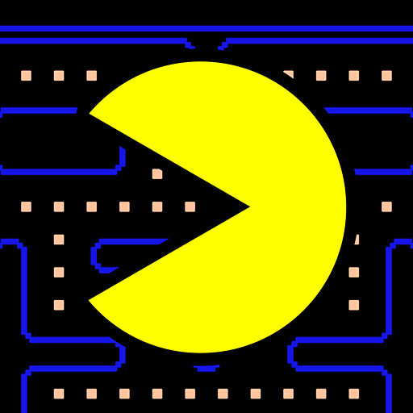
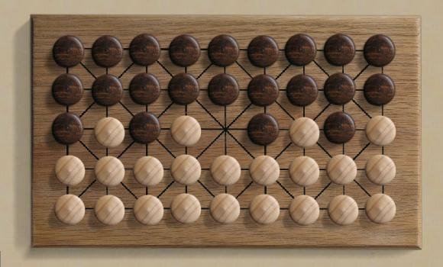
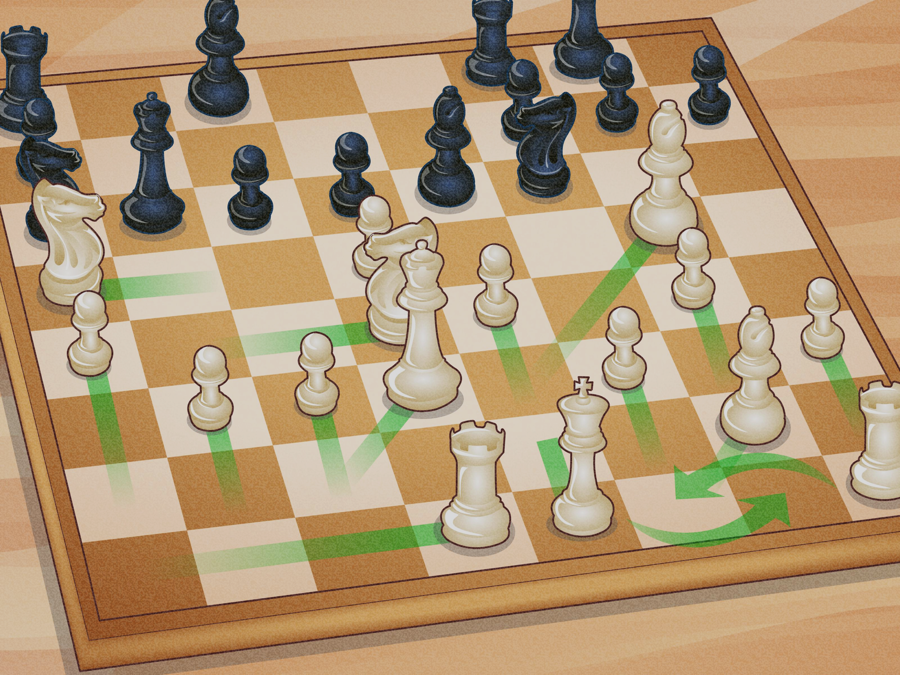
Well because,
Games are one of the best forms of popular INTERACTIVE MEDIA used today.
They are one of the best ways to CHALLENGE ourselves and think INNOVATIVELY.
And who doesn’t like to PLAY GAMES...

Slide 5
HOW IS AI USED IN GAMING ?

Slide 6


A.I. IN GAMING
THE CONCEPTS OF AI ARE IMPLEMENTED AND IMPROVED UPON EVERY DAY TO ENHANCE PERFORMANCE IN GAMING AND SIMULATION BY CONGLOMERATES LIKE NVIDIA, AMD, INTEL ETC.
PLAYING AGAINST AN AI OPPONENT IS THE CLOSEST TO PLAYING AGAINST A HUMAN PEER.
EVEN IN OUR PROJECT, WE PLAY AGAINST AN AI OPPONENT USING DEPTH SEARCHING ALGORITHMS LIKE ALPHA-BETA PRUNING AND HEURISTIC SEARCHING.

Slide 7
WHY HAVE WE CHOSEN FANORONA AS OUR GAME ?

Slide 8
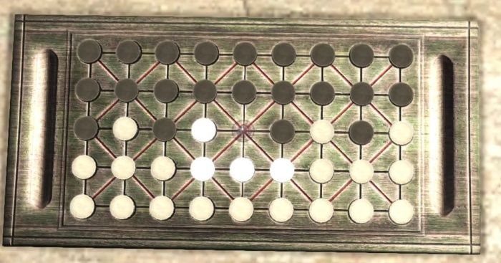
A LITTLE ABOUT FANORONA….
ORIGINATING IN THE ISLANDS OF MADAGASCAR, THE GAME IS QUITE SIMILAR TO CHECKERS, THOUGH NOT QUITE THE SAME..
IT CAN BE PLAYED ON THREE DIFFERENT FORMATS, NAMELY ON A 3X3, 5X5 AND A 9X5 BOARD. RULES OF FANORONA ARE A BIT COMPLEX THAN THAT OF CHECKERS, WHICH EFFECTS ITS RESPECTIVE COMPLEXITY AS WELL.

Slide 9
START
GAME MOVE
PLAYING STEPS FLOWCHART
MOVE IS LEGAL
FALSE
MOVE IS APPLIED
ALL PIECES CAPTURED
TRUE
END

Slide 10
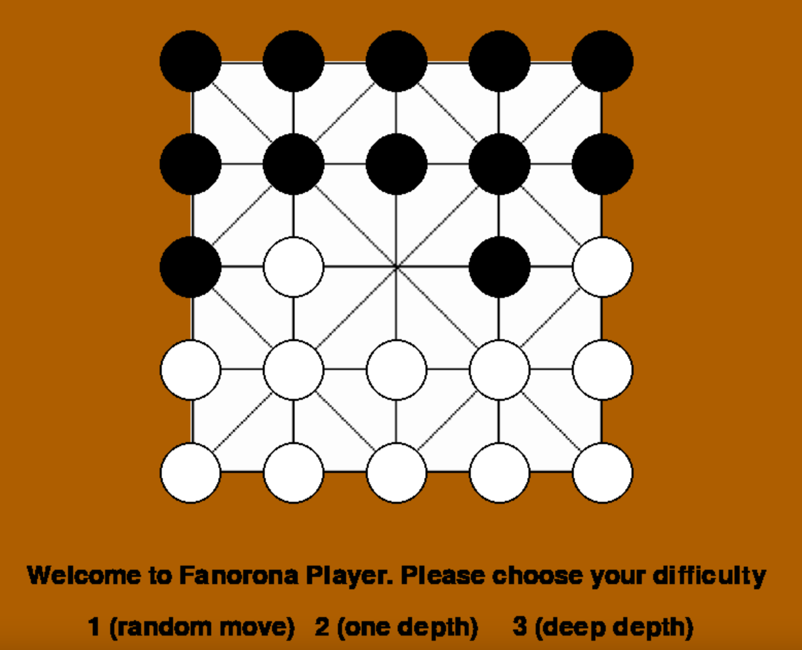
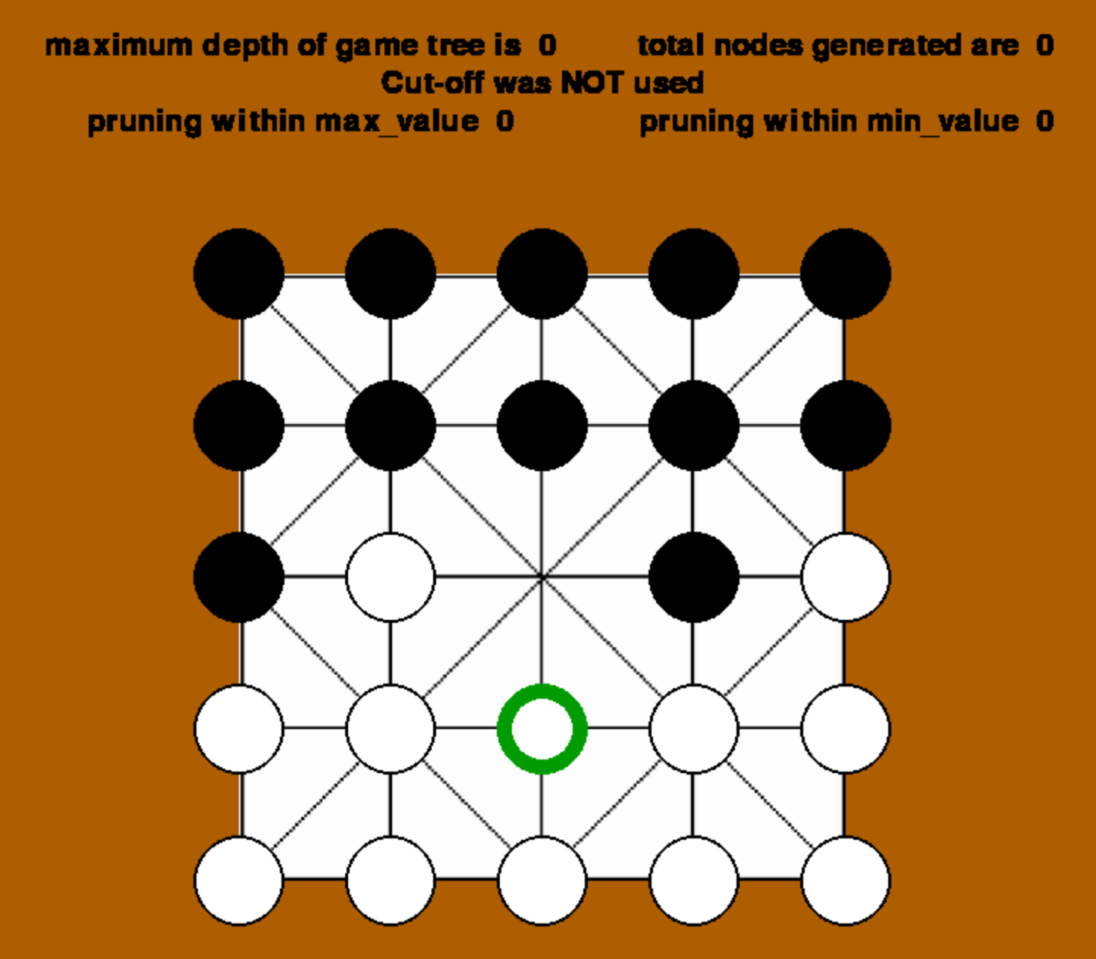
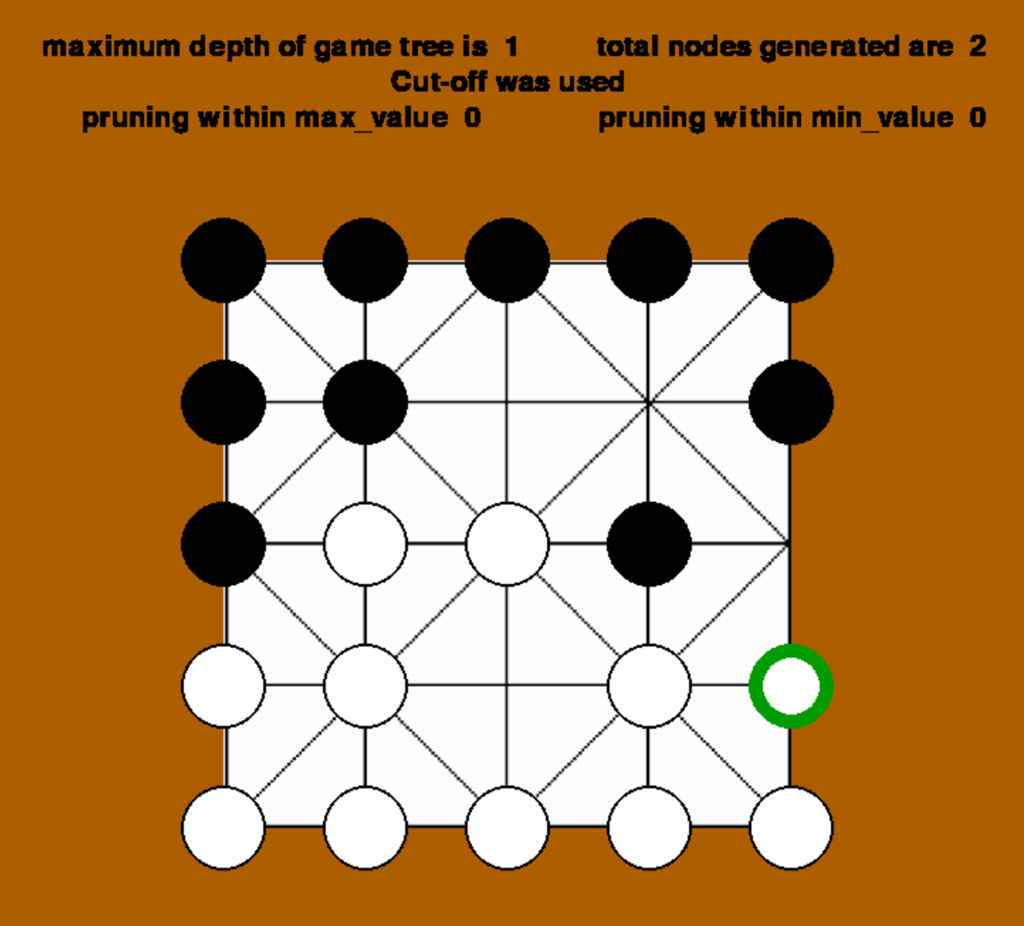
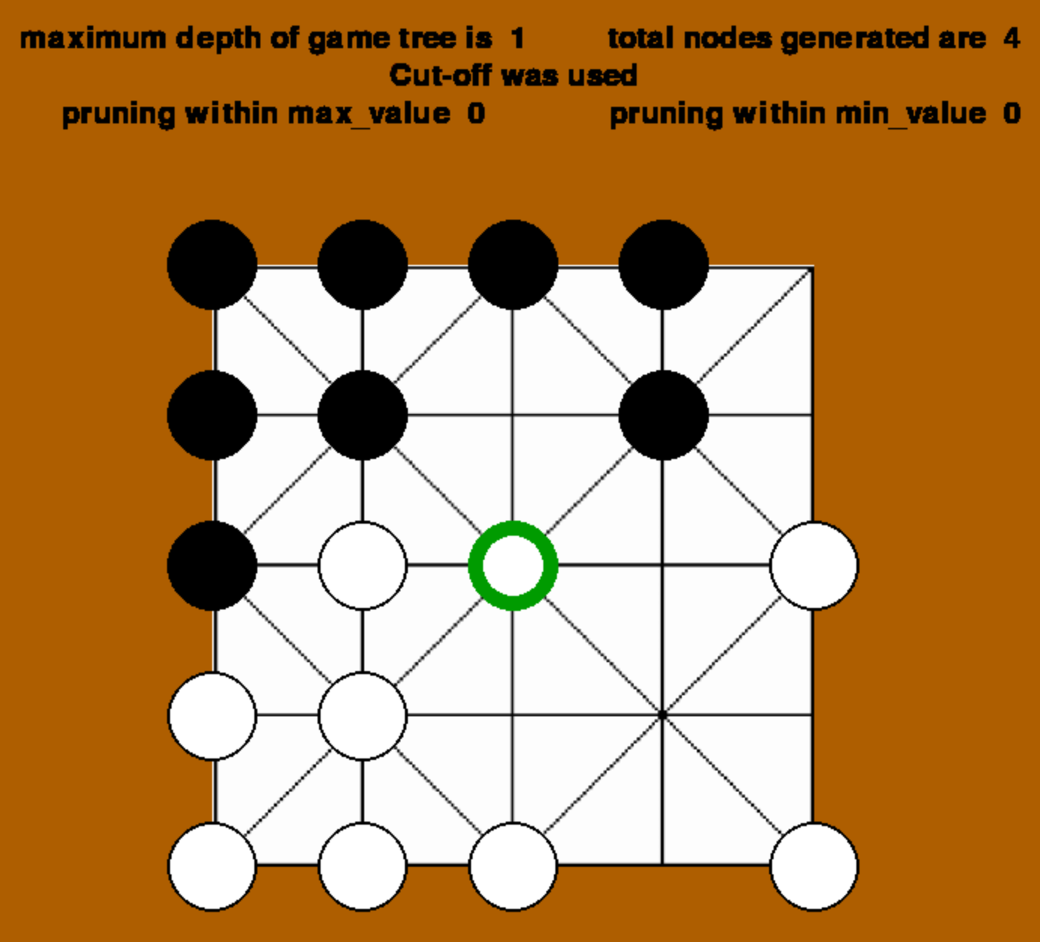
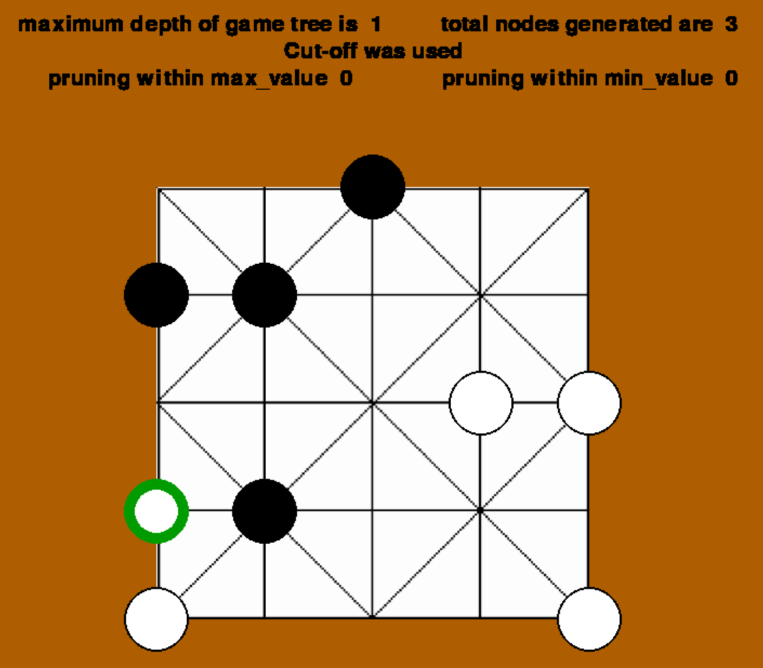
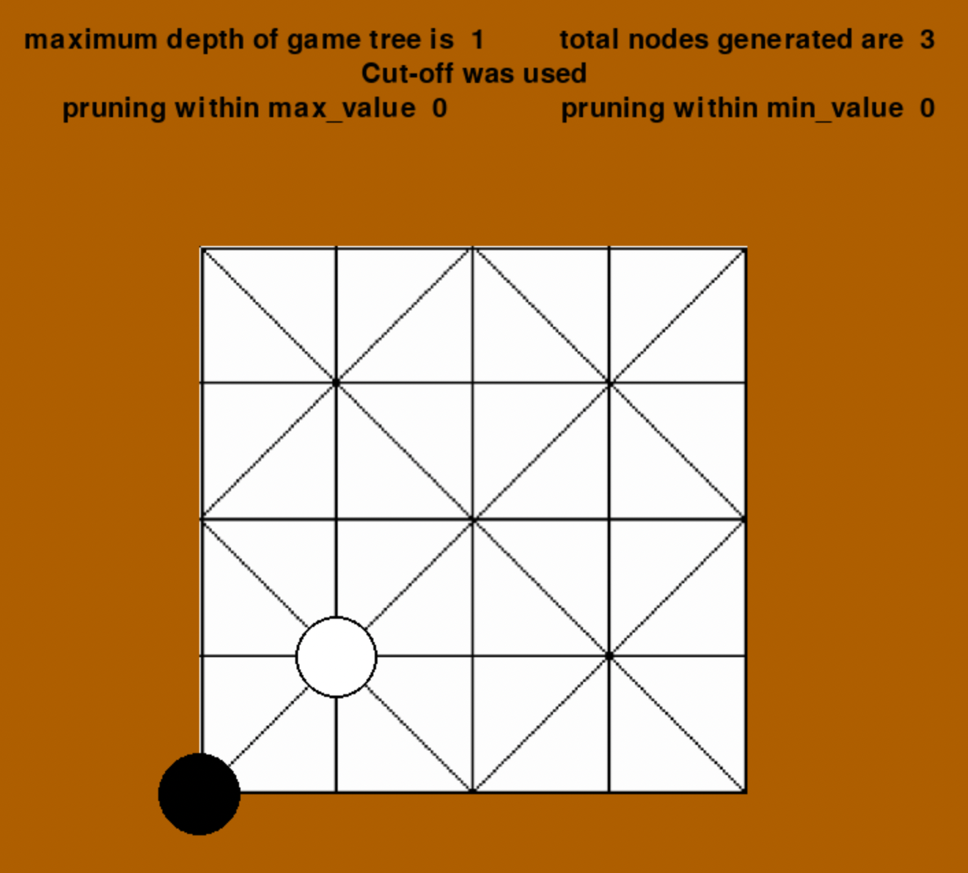

Slide 11
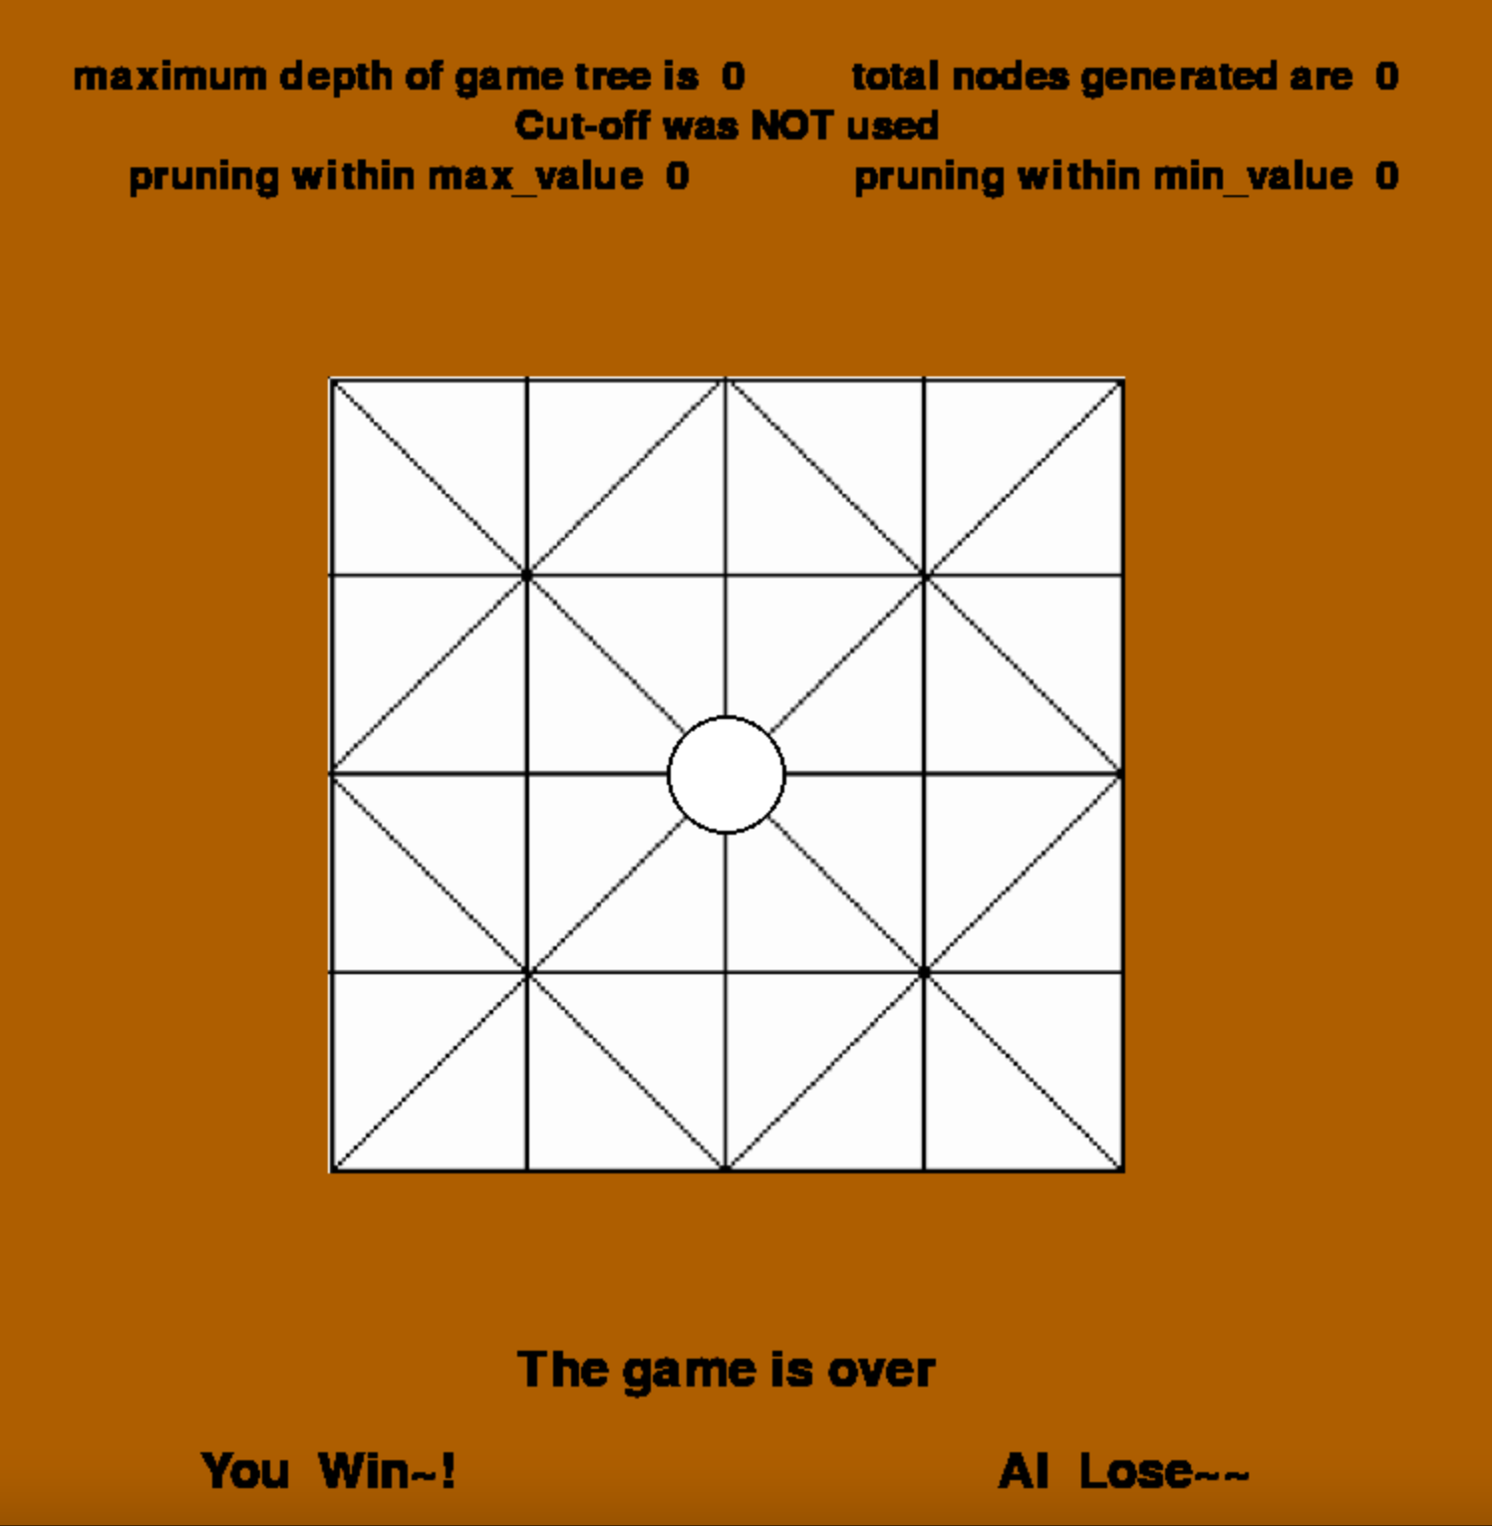
THE ENDGAME

Slide 12
THANK YOU

